Slide 1
DYNAMIC RESPONSES FOR AUTOMATED THREATS
Uriel Erlikh - R&D developer at Check Point, Interested in cyber research Meir Kalman - R&D developer at Check Point, Interested in cyber research The project on behalf of IMPERVA company, led by Sarit Yerushalmi

Slide 2
PROJECT OBJECTIVE
Automated threats
are a significant part
of online attacks

Slide 3


PROJECT OBJECTIVE
Problem:
Attackers know when
WAF Blocks them
Solution:
Use dynamic responses to mislead attackers

Slide 4
BANK OF DYNAMIC RESPONSES
Fake HTML page
Abort connection 503
Hold the session
Sleep 200 OK
Empty response
Dynamic data intervention

Slide 5





ARCHITACTURE
internet
proxy
victim website
attacker
Return dynamic response

Slide 6


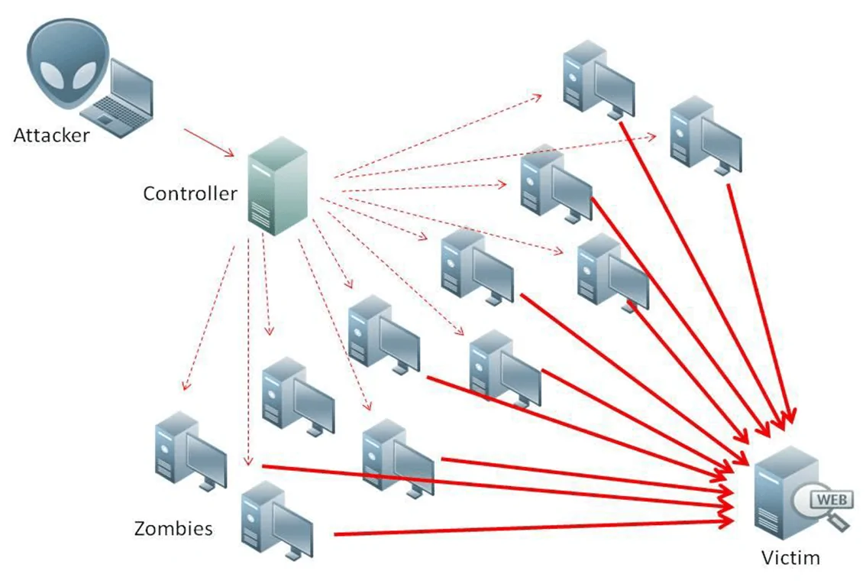


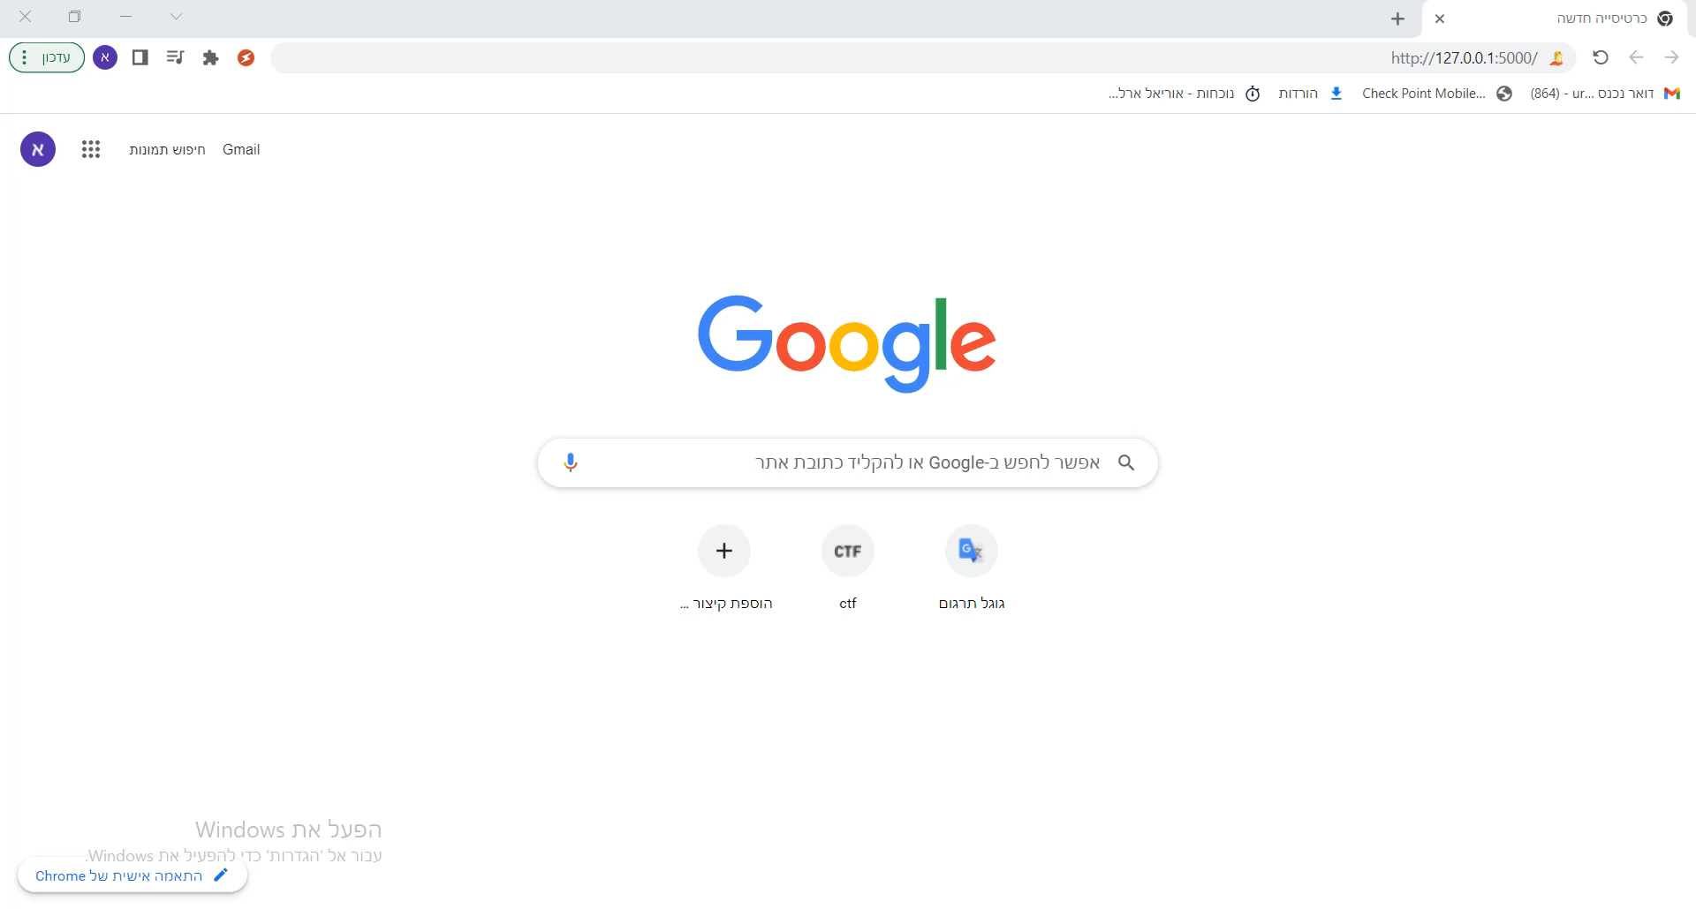
Demo Time
Sclaping Attack
Credential Cracking
DOS Attack

